Slide 1
Supervised Learning
Rasoul Ameri

Slide 2
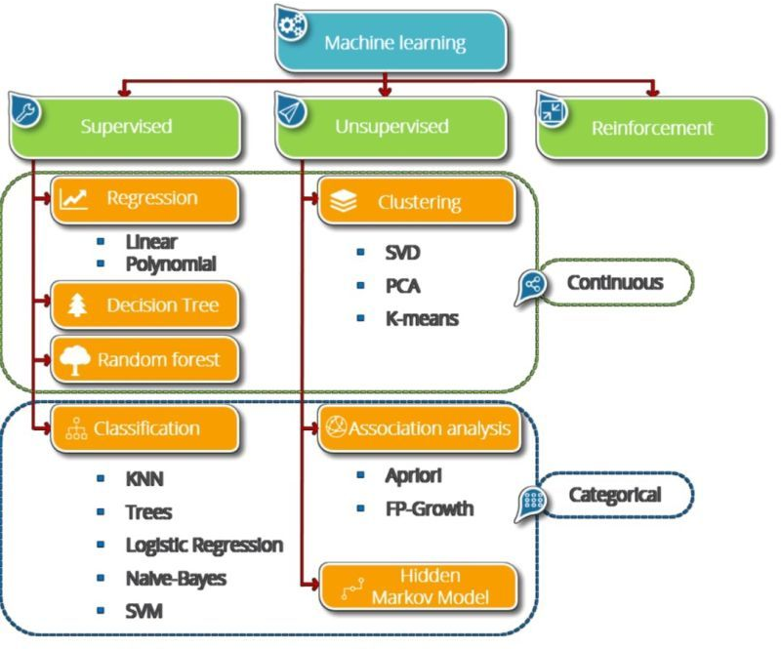
Background

Slide 3
Background
Machine Learning Methods
Supervised:
Classification
i.e. SVM, NN, …
Regression
i.e. linear, SVR, …
Unsupervised:
- Clustering
- Dimensionality reduction
Reinforcement Learning

Slide 4
The Learning Problem
Learning from data is used in situations where we don’t have any analytic solution, but we do have data that we can use to construct an empirical solution.
The basic premise of learning from data is the use of a set of observations to uncover an underlying process.
To this aim, we should create a predictive model

Slide 5
Predictive model
The three aspects of predictive modeling
Create model and use it
Training data
Algorithm
Create Model
Sample Data
Learn a model
Making predictions
1
2
New Data
???
Model
Predictions
3

Slide 6

Predictive model
The most common type of machine learning is to learn the mapping $\text{Y}\text{=}\text{f}\text{(}\text{X}\text{)}$ to make predictions of Y for new X.
f(x): target function
X: input variables
Y: output variables.
Regression
Y
Quantitative
Qualitative
Ordinal: possesses a natural ordering (e.g. shirt sizes)
Nominal: just name the categories (e.g. marital status, gender, etc.)
Measurements or counts, recorded as numerical values (e.g. height, temperature, etc.)
Classification

Slide 7
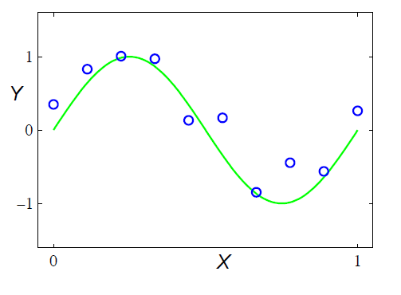

Regression - Example
Regression:
$f:X→Y$
$X∈ℜ$
$Y∈ℜ$
Dataset
10 (X,Y) points generated from a sin function, with noise

Slide 8
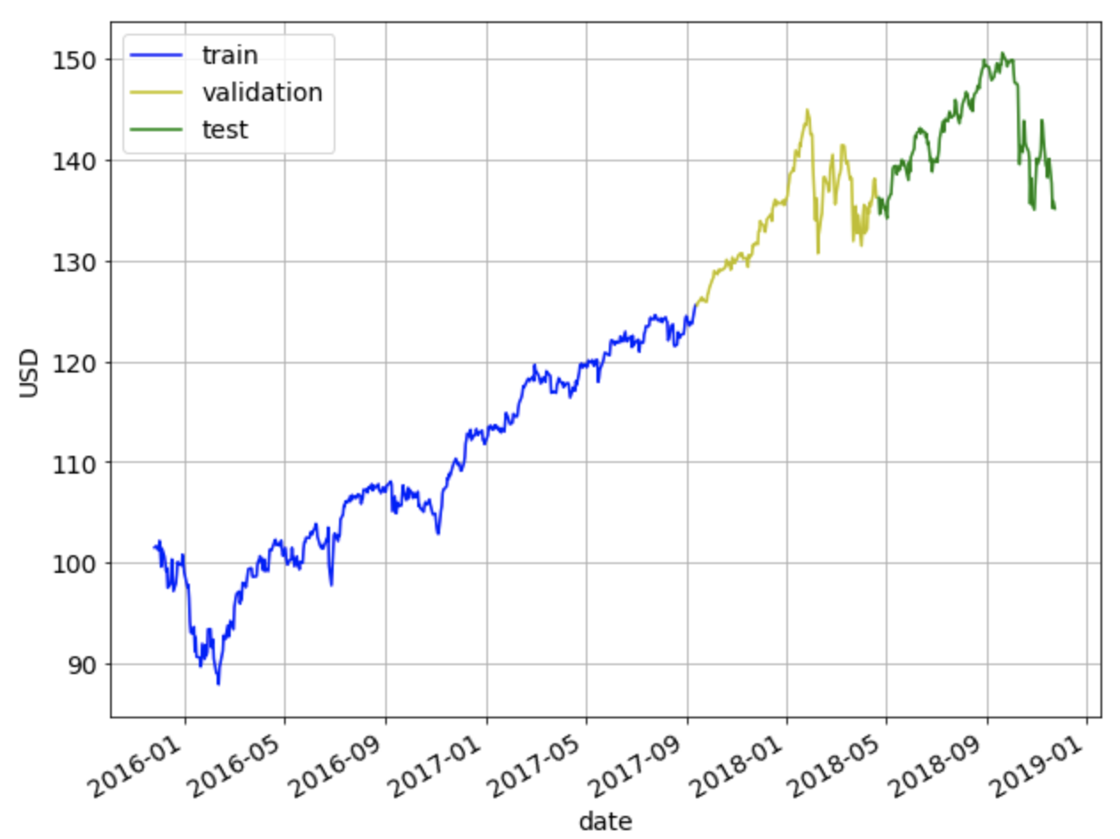
Regression - Example
Stock Market
Prediction

Slide 9
Classification

Slide 10
Classification VS Regression
Regression
Covers situations where Y is continuous (quantitative)
E.g. predicting the value of the Rainfall in 6 months.
Classification
Covers situations where Y is categorical (qualitative)
E.g. Will the Rainfall be up or down in 6 months?

Slide 11
Regression (summary)
A regression problem requires the prediction of a quantity.
Multivariate regression problem: a problem with multiple input variables.
Time series forecasting problem: a regression problem where input variables are ordered by time.
Regression is the task of predicting a continuous quantity.

Slide 12
Classification (summary)
A classification problem requires that examples be classified into one of two or more classes.
Binary classification problem: a problem with two classes.
Multi-class classification problem: a problem with more than two classes.
Classification is the task of predicting a discrete class label.

Slide 13
Next session
Classification methods
and
using PYTHON
for
implementation

